Slide 1
Economic Snapshot
CNMI Economy 2018

Slide 2
INTRODUCTION
Our mission
To create a comprehensive understanding of the CNMI economy in order to promote data driven solutions in the public and private sector.
What we do
We provide the public and private sector a range of economic and statistical methods to create a better picture of the environment and context which decisions are made
What is Hive Analytics?
How we do it
Ask the right questions. Find the available data. Develop the models. Apply the findings

Slide 3
We Ask
Building a better understanding of the CNMI Economy relies on asking the right questions
“When is the right time to invest?”
What are the economic conditions today and where is our economy going are crucial questions toward deciding the right time to invest your time and money.
“Who is my target market for my product?”
The domestic market is only one segment of the potential market base when the CNMI has a large transient population. What are the potential gains from either market and where are the opportunities for growth and export?
“How do I grow my business in the future?”
Small business expansion is a key driver of larger economic development, but expansion appears risky if the data is not present.

Slide 4
FIVE BIGGEST INDICATORS and what they mean for you
1
2
3
4
5
Broader economic momentum – Gross Domestic Product
Domestic Demand – Consumer Price Index
CNMI Exports – Tourism Figures
Government Expenditures
Labor
Reference : The basics you can find anywhere 5 Steps To Successful Storytelling Published on April 5, 2014 Featured in: Marketing & Advertising

Slide 5
1
CNMI Gross Domestic Product (GDP)
$1,242 Billion in 2016
28.6% Increase over 2015
Why does that matter?

Slide 6
Gross Domestic Product (CNMI)
Source: US Bureau of Economic Analysis

Slide 7
GDP to New Business Development
Source: CNMI Department of Finance

Slide 8
“Exports of services was the largest contributor to economic growth in 2016, reflecting significant growth in visitor spending, particularly on casino gambling. The number of visitors to the CNMI grew over 10 percent, primarily reflecting an increase in visitor arrivals from Korea and China.”
—U.S. BUREAU OF ECONOMIC ANALYSIS

Slide 9
2
Consumer Price Index (CPI)
Price Increases
Why they are not always a bad sign

Slide 10
Increasing Price Stability and Indicator of Growing Demand
Source: CNMI Department of Commerce

Slide 11
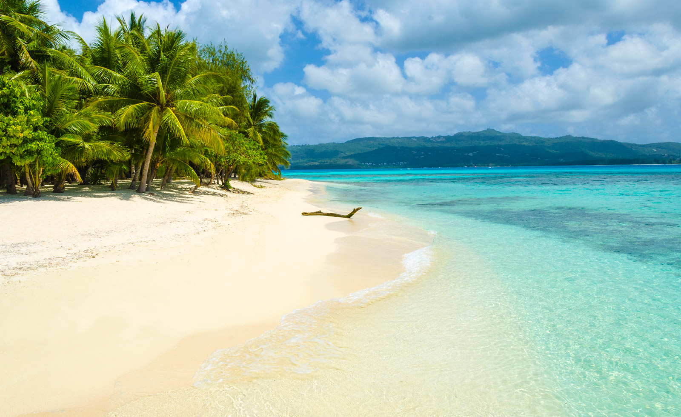
3
Tourism
Primary Export Market
Tourism figures represent more than hotel revenue
Increased arrivals indicate capital inflows to wider economy

Slide 12
Total Visitor Arrivals on a Consistent Climb
Source: Marianas Visitors Authority

Slide 13
Korean Market to Total Arrivals
Source: Marianas Visitors Authority

Slide 14
Chinese Market to Total Arrivals
Source: Marianas Visitors Authority

Slide 15
Major Source Markets
Source: Marianas Visitors Authority

Slide 16
Competition within the Region Exists
Source: Guam Hotel & Restaurant Association

Slide 17
Competition within the Region Exists
Source: Guam Hotel & Restaurant Association

Slide 18
4
Government Expenditures
Market Failure Corrections
And capital injections into the wider economy
Government Expenditures stimulate economic growth

Slide 19
Economic Impact of OIA Payments
Source: US Office of Insular Affairs

Slide 20
5
Labor
Critical Limitation on Growth
Labor is an essential factor of production for any economy. Without workers, especially in a service based economy, you have no growth

Slide 21
CNMI Labor Force – Foreign and Domestic Workers

Slide 22
GDP & US Worker Growth

Slide 23
GDP per Worker

Slide 24
CW-1 Numerical Limitations

Slide 25
“The current number of unemployed domestic workers is insufficient to replace the existing CW-1 workers or to fill all the nonconstruction jobs that planned development projects are expected to create once their business operations commence.”
—U.S. Government Accountability Office

Slide 26
Many Opportunities
Risk
Room to Help
Your success will offer benefits for your lives but also help build a stronger and more resilient community

Slide 27
The time to repair the roof is
when the sun is shining.
—John F. Kennedy

Slide 28
Thank you

